Slide 1

CFO HELPER
-Smart Financial Scenario Simulator
MAKING FINANCIAL DECISIONS SIMPLE AND VISUAL
Team: VORTEX | Code: b5952ed8

Slide 2
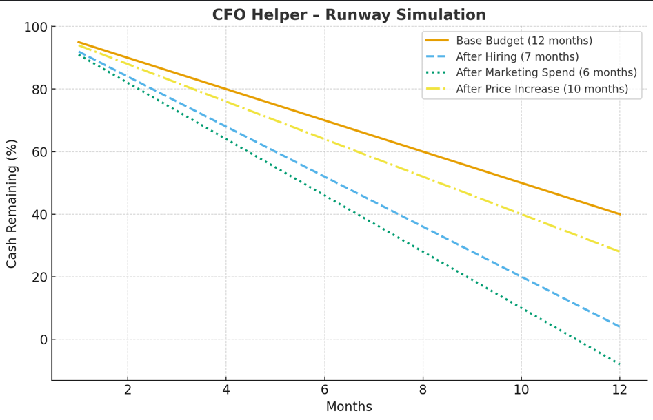
Problem Statement
- Startups and small teams struggle with managing budgets.
- Excel sheets don’t give clear “what if” answers.
- Decisions like hiring, marketing spend, or pricing changes are guesswork.
- Need: A tool that shows financial outcomes instantly.
Typical questions:
“If I hire 2 more engineers, can I survive 6 months?”
“If I spend ₹10,000 extra on marketing, what’s left for prizes?”
“If I increase product price by 10%, what happens to profit?”

Slide 3
Our Solution
Demo Flow
CFO Helper Agent:
- Simple UI with sliders for spending, hiring, pricing.
- Instantly shows budget impact with charts.
- Generates sharable financial scenario reports.
- Updates forecasts when new financial data arrives.
Start with a base budget → runway = M months.
Slide “hire x engineers” → runway drops to M-N months.
Increase marketing spend by ₹ X,X0,000 → cash buffer shrinks further.
Raise product price by P% → profit improves, runway extends.
Export/share report → counts as N credit usage.

Slide 4
Key Features
🎚️ Scenario Simulation – Adjust hiring, spending, pricing.
📊 Visual Forecasts – Clear charts for budget & runway.
🔮 What-If Analysis – Compare different outcomes instantly.
📑 Report Export – Shareable summaries in one click.
⏱️ Usage Tracking – Credits per simulation/report.
🔄 Live Data Updates – Auto-refresh with Pathway integration.

Slide 5
Implementation & Demo Plan
Step 1 → Frontend
Build UI with sliders (hiring, spending, pricing) + charts for budget/runway.
Step 2 → Backend
FastAPI handles scenario logic and calculations.
Step 3 → Integrations
Flexprice → track credits per simulation/report.
Pathway → pull live/mock financial data.
Step 4 → Demo
*Base budget = 12 months runway
*Hire 2 engineers → drops to 7 months
*Extra ₹10,000 marketing → cash reduces further
*Price +10% → runway improves
*Export report → 1 credit used

Slide 6
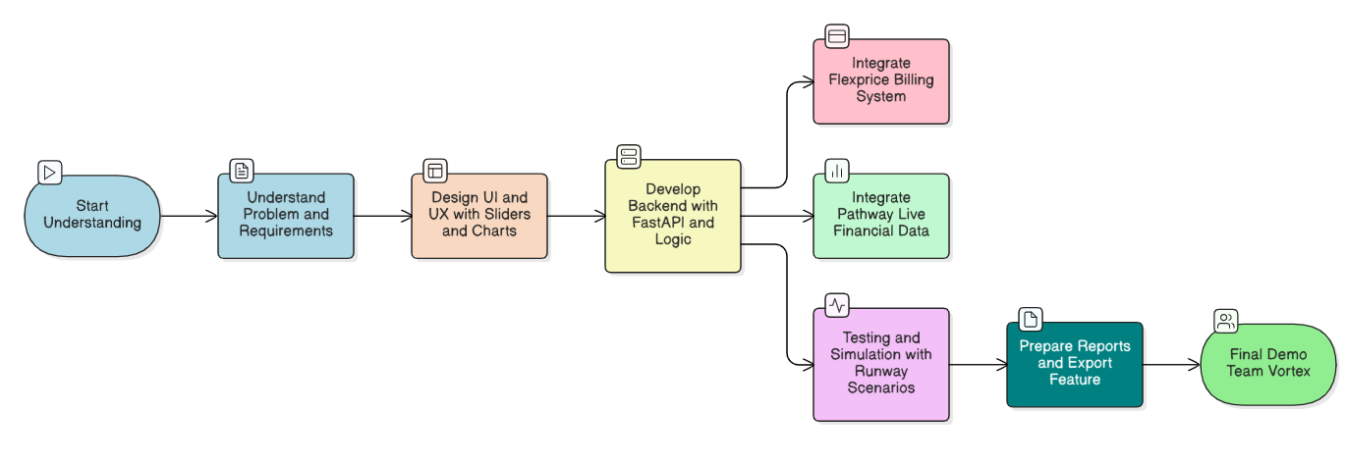
Implementation Flow

Slide 7
Team Details – Vortex | b5952ed8
SHAIK MOHAMMED JUNAID
📧 smjunaid.dev@gmail.com
PATHAN MUBASSHIR KHAN
📧 mubasshirkhan_pathan@srmap.edu.in
PULICHINTHALA RANGANATH
📧 ranganath_pulichinthala@srmap.edu.in
RITWIK PARAMESH
📧 ritwikparamesh4959@gmail.com
✨ Blending Tech, Finance, and Design to make smarter decisions simple.

